Slide 1
Operating System Presentation
Prepared By Sumon Karmakar

Slide 2
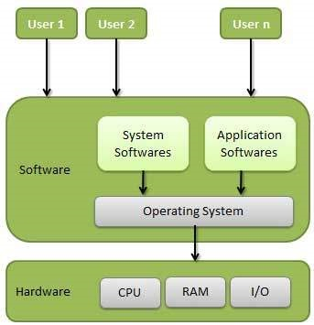
Operating System Presentation
Definition:- An operating system is a program that acts as an interface between the user and the computer hardware and controls the execution of all kinds of programs.

Slide 3
Operating System Presentation
Important function of an operating system:- These are some important functions that are performed by operating system.
Memory Management
Processor Management
Device Management
File Management
Security
Control over system performance
Job accounting
Error detecting aids
Coordination between other software and users

Slide 4
Operating System Presentation
Types of Operating System:- There are different types of Operating System. They are as follows:
Batch Operating System
Time Sharing Operating System
Distribute Operating System
Network Operating System
Real Time Operating System

Slide 5
Operating System Presentation
Types of Operating System:-
Batch Operating System:- The users of a batch operating system do not interact with the computer directly. Each user prepares his job on an off-line device like punch cards and submits it to the computer operator. To speed up processing, jobs with similar needs are batched together and run as a group. The programmers leave their programs with the operator and the operator then sorts the programs with similar requirements into batches.
The problems with Batch Systems are as follows −
Lack of interaction between the user and the job.
CPU is often idle, because the speed of the mechanical I/O devices is slower than the CPU.
Difficult to provide the desired priority.

Slide 6
Operating System Presentation
Types of Operating System:-
Time Sharing Operating System:- Time-sharing is a technique which enables many people, located at various terminals, to use a particular computer system at the same time. Time-sharing or multitasking is a logical extension of multiprogramming. Processor's time which is shared among multiple users simultaneously is termed as time-sharing.
The main difference between Multiprogrammed Batch Systems and Time-Sharing Systems is that in case of Multiprogrammed batch systems, the objective is to maximize processor use, whereas in Time-Sharing Systems, the objective is to minimize response time.

Slide 7
Operating System Presentation
Types of Operating System:-
Advantages of Time Sharing Operating System:-
Provides the advantage of quick response.
Avoids duplication of software.
Reduces CPU idle time.
Disadvantages of Time Sharing Operating System:-
Problem of reliability.
Question of security and integrity of user programs and data.
Problem of data communication.

Slide 8
Operating System Presentation
Types of Operating System:-
Distributed Operating System:- Distributed systems use multiple central processors to serve multiple real-time applications and multiple users. Data processing jobs are distributed among the processors accordingly.
Advantages:-With resource sharing facility, a user at one site may be able to use the resources available at another.
Speedup the exchange of data with one another via electronic mail.
If one site fails in a distributed system, the remaining sites can potentially continue operating.
Better service to the customers.
Reduction of the load on the host computer.
Reduction of delays in data processing.

Slide 9
Operating System Presentation
Types of Operating System:-
Network Operating System:- A Network Operating System runs on a server and provides the server the capability to manage data, users, groups, security, applications, and other networking functions. The primary purpose of the network operating system is to allow shared file and printer access among multiple computers in a network, typically a local area network (LAN), a private network or to other networks.

Slide 10
Operating System Presentation
Types of Operating System:-
Advantages of Network Operating System:-
Centralized servers are highly stable.
Security is server managed.
Upgrades to new technologies and hardware can be easily integrated into the system.
Remote access to servers is possible from different locations and types of systems.
Disadvantages of Network Operating System:-
High cost of buying and running a server.
Dependency on a central location for most operations.
Regular maintenance and updates are required.

Slide 11
Operating System Presentation
Types of Operating System:-
Real Time Operating System:- A real-time system is defined as a data processing system in which the time interval required to process and respond to inputs is so small that it controls the environment. The time taken by the system to respond to an input and display of required updated information is termed as the response time. So in this method, the response time is very less as compared to online processing.

Slide 12
Operating System Presentation
Services performed by Operating System:-
An Operating System provides services to both the users and to the programs.
It provides programs an environment to execute.
It provides users the services to execute the programs in a convenient manner.
Following are a few common services provided by an operating system −
Program execution
I/O operations
File System manipulation
Communication
Error Detection
Resource Allocation
Protection

Slide 13
Operating System Presentation
Batch Processing:-
Batch processing is a technique in which an Operating System collects the programs and data together in a batch before processing starts. An operating system does the following activities related to batch processing −
The OS defines a job which has predefined sequence of commands, programs and data as a single unit.
The OS keeps a number a jobs in memory and executes them without any manual information.
Jobs are processed in the order of submission, i.e., first come first served fashion.
When a job completes its execution, its memory is released and the output for the job gets copied into an output spool for later printing or processing.

Slide 14
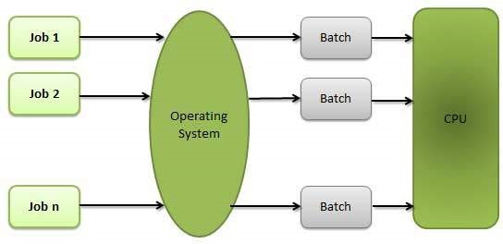
Operating System Presentation
Batch Processing:-

Slide 15
Operating System Presentation
Batch Processing:-
Advantages:-
Batch processing takes much of the work of the operator to the computer.
Increased performance as a new job get started as soon as the previous job is finished, without any manual intervention.
Disadvantages:-
Difficult to debug program.
A job could enter an infinite loop.
Due to lack of protection scheme, one batch job can affect pending jobs.

Slide 16
Operating System Presentation
Multitasking:- Multitasking is when multiple jobs are executed by the CPU simultaneously by switching between them. Switches occur so frequently that the users may interact with each program while it is running. An OS does the following activities related to multitasking −
The user gives instructions to the operating system or to a program directly, and receives an immediate response.
The OS handles multitasking in the way that it can handle multiple operations/executes multiple programs at a time.
Multitasking Operating Systems are also known as Time-sharing systems.
These Operating Systems were developed to provide interactive use of a computer system at a reasonable cost.
A time-shared operating system uses the concept of CPU scheduling and multiprogramming to provide each user with a small portion of a time-shared CPU.
Each user has at least one separate program in memory.

Slide 17
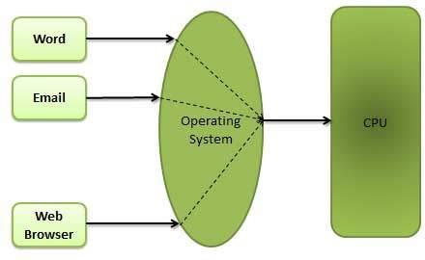
Operating System Presentation
Multitasking:-

Slide 18
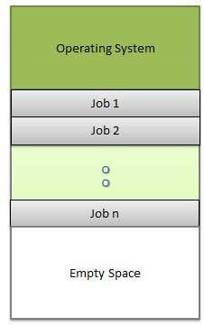
Operating System Presentation
Multiprogramming:- Sharing the processor, when two or more programs reside in memory at the same time, is referred as multiprogramming. Multiprogramming assumes a single shared processor. Multiprogramming increases CPU utilization by organizing jobs so that the CPU always has one to execute.

Slide 19
Operating System Presentation
Multiprogramming:-
Advantages
High and efficient CPU utilization.
User feels that many programs are allotted CPU almost simultaneously.
Disadvantages
CPU scheduling is required.
To accommodate many jobs in memory, memory management is required.

Slide 20
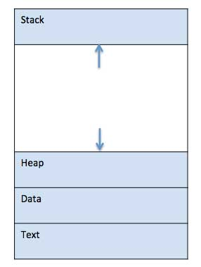
Operating System Presentation
Process:- A process is basically a program in execution. The execution of a process must progress in a sequential fashion.
A process is defined as an entity which represents the basic unit of work to be implemented in the system.

Slide 21
Operating System Presentation
Process life cycle:- When a process executes, it passes through different states. These stages may differ in different operating systems, and the names of these states are also not standardized.

Slide 22
Operating System Presentation
Process life cycle:-
S.N. | State & Description
1 | Start This is the initial state when a process is first started/created.
2 | Ready The process is waiting to be assigned to a processor. Ready processes are waiting to have the processor allocated to them by the operating system so that they can run. Process may come into this state after Start state or while running it by but interrupted by the scheduler to assign CPU to some other process.
3 | Running Once the process has been assigned to a processor by the OS scheduler, the process state is set to running and the processor executes its instructions.
4 | Waiting Process moves into the waiting state if it needs to wait for a resource, such as waiting for user input, or waiting for a file to become available.
5 | Terminated or Exit Once the process finishes its execution, or it is terminated by the operating system, it is moved to the terminated state where it waits to be removed from main memory.

Slide 23
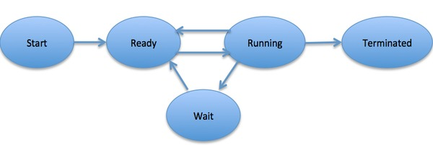
Operating System Presentation
Process life cycle:-

Slide 24
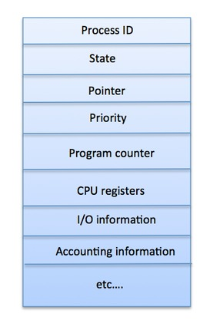
Operating System Presentation
Process Control Block(PCB):- A Process Control Block is a data structure maintained by the Operating System for every process. The PCB is identified by an integer process ID (PID).

Slide 25
Operating System Presentation
Process Scheduling Queues:-
Definition:- The process scheduling is the activity of the process manager that handles the removal of the running process from the CPU and the selection of another process on the basis of a particular strategy.
The Operating System maintains the following important process scheduling queues −
Job queue − This queue keeps all the processes in the system.
Ready queue − This queue keeps a set of all processes residing in main memory, ready and waiting to execute. A new process is always put in this queue.
Device queues − The processes which are blocked due to unavailability of an I/O device constitute this queue.

Slide 26
Operating System Presentation
Process Scheduling Queues:-
The OS maintains all PCBs in Process Scheduling Queues. The OS maintains a separate queue for each of the process states and PCBs of all processes in the same execution state are placed in the same queue. When the state of a process is changed, its PCB is unlinked from its current queue and moved to its new state queue.

Slide 27
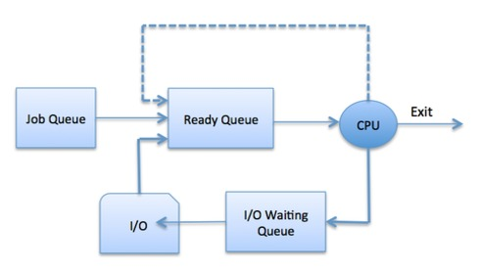
Operating System Presentation
Process Scheduling Queues:- The Operating System maintains the following important process scheduling queues −
Job queue − This queue keeps all the processes in the system.
Ready queue − This queue keeps a set of all processes residing in main memory, ready and waiting to execute. A new process is always put in this queue.
Device queues − The processes which are blocked due to unavailability of an I/O device constitute this queue.

Slide 28
Operating System Presentation
Two State Process Model:-
S.N. | State & Description
1 | Running When a new process is created, it enters into the system as in the running state.
2 | Not Running Processes that are not running are kept in queue, waiting for their turn to execute. Each entry in the queue is a pointer to a particular process. Queue is implemented by using linked list. Use of dispatcher is as follows. When a process is interrupted, that process is transferred in the waiting queue. If the process has completed or aborted, the process is discarded. In either case, the dispatcher then selects a process from the queue to execute.

Slide 29
Operating System Presentation
Schedulers:- Schedulers are special system software which handle process scheduling in various ways. Their main task is to select the jobs to be submitted into the system and to decide which process to run. Schedulers are of three types −
Long-Term Scheduler
Short-Term Scheduler
Medium-Term Scheduler

Slide 30
Operating System Presentation
Long-Term Schedulers:- It is also called a job scheduler. A long-term scheduler determines which programs are admitted to the system for processing. It selects processes from the queue and loads them into memory for execution. Process loads into the memory for CPU scheduling.
The primary objective of the job scheduler is to provide a balanced mix of jobs, such as I/O bound and processor bound. It also controls the degree of multiprogramming. If the degree of multiprogramming is stable, then the average rate of process creation must be equal to the average departure rate of processes leaving the system.
On some systems, the long-term scheduler may not be available or minimal. Time-sharing operating systems have no long term scheduler. When a process changes the state from new to ready, then there is use of long-term scheduler.

Slide 31
Operating System Presentation
Short-Term Schedulers:- It is also called as CPU scheduler. Its main objective is to increase system performance in accordance with the chosen set of criteria. It is the change of ready state to running state of the process. CPU scheduler selects a process among the processes that are ready to execute and allocates CPU to one of them.
Short-term schedulers, also known as dispatchers, make the decision of which process to execute next. Short-term schedulers are faster than long-term schedulers.

Slide 32
Operating System Presentation
Medium-Term Schedulers:- Medium-term scheduling is a part of swapping. It removes the processes from the memory. It reduces the degree of multiprogramming. The medium-term scheduler is in-charge of handling the swapped out-processes.
A running process may become suspended if it makes an I/O request. A suspended processes cannot make any progress towards completion. In this condition, to remove the process from memory and make space for other processes, the suspended process is moved to the secondary storage. This process is called swapping, and the process is said to be swapped out or rolled out. Swapping may be necessary to improve the process mix.

Slide 33
Operating System Presentation
Context Switch:- A context switch is the mechanism to store and restore the state or context of a CPU in Process Control block so that a process execution can be resumed from the same point at a later time. Using this technique, a context switcher enables multiple processes to share a single CPU. Context switching is an essential part of a multitasking operating system features.
When the scheduler switches the CPU from executing one process to execute another, the state from the current running process is stored into the process control block. After this, the state for the process to run next is loaded from its own PCB and used to set the PC, registers, etc. At that point, the second process can start executing.

Slide 34
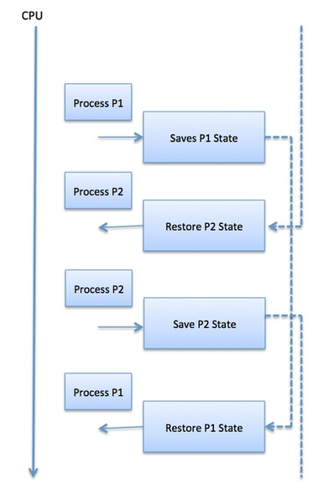
Operating System Presentation
Context Switch:-

Slide 35
Operating System Presentation
Operating System Scheduling Algorithm:- A Process Scheduler schedules different processes to be assigned to the CPU based on particular scheduling algorithms. There are six popular process scheduling algorithms which we are going to discuss in this chapter −
First-Come, First-Served (FCFS) Scheduling
Shortest-Job-Next (SJN) Scheduling
Priority Scheduling
Shortest Remaining Time
Round Robin(RR) Scheduling
Multiple-Level Queues Scheduling

Slide 36
Operating System Presentation
Operating System Scheduling Algorithm:-
First-Come, First-Served (FCFS) Scheduling:-
Jobs are executed on first come, first serve basis.
It is a non-preemptive, pre-emptive scheduling algorithm.
Easy to understand and implement.
Its implementation is based on FIFO queue.
Poor in performance as average wait time is high.

Slide 37
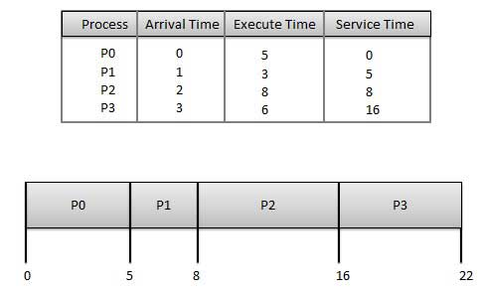
Operating System Presentation
Operating System Scheduling Algorithm:-
First-Come, First-Served (FCFS) Scheduling:-

Slide 38
Operating System Presentation
Operating System Scheduling Algorithm:-
First-Come, First-Served (FCFS) Scheduling:- Wait time of each process is as follows −
Average Wait Time: (0+4+6+13) / 4 = 5.75
Process | Wait Time : Service Time - Arrival Time
P0 | 0 - 0 = 0
P1 | 5 - 1 = 4
P2 | 8 - 2 = 6
P3 | 16 - 3 = 13

Slide 39
Operating System Presentation
Operating System Scheduling Algorithm:-
Shortest Job Next (SJN) Scheduling:- This is also known as shortest job first, or SJF
This is a non-preemptive, pre-emptive scheduling algorithm.
Best approach to minimize waiting time.
Easy to implement in Batch systems where required CPU time is known in advance.
Impossible to implement in interactive systems where required CPU time is not known.
The processer should know in advance how much time process will take.

Slide 40
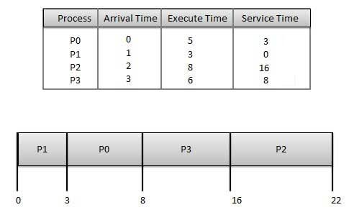
Operating System Presentation
Operating System Scheduling Algorithm:-
Shortest Job Next (SJN) Scheduling:-

Slide 41
Operating System Presentation
Operating System Scheduling Algorithm:-
Shortest Job Next (SJN) Scheduling:- Wait time of each process is as follows −
Process | Wait Time : Service Time - Arrival Time
P0 | 3 - 0 = 3
P1 | 0 - 0 = 0
P2 | 16 - 2 = 14
P3 | 8 - 3 = 5
Average Wait Time: (3+0+14+5) / 4 = 5.50

Slide 42
Operating System Presentation
Operating System Scheduling Algorithm:-
Priority Based Scheduling:- Priority scheduling is a non-preemptive algorithm and one of the most common scheduling algorithms in batch systems.
Each process is assigned a priority. Process with highest priority is to be executed first and so on.
Processes with same priority are executed on first come first served basis.
Priority can be decided based on memory requirements, time requirements or any other resource requirement.

Slide 43
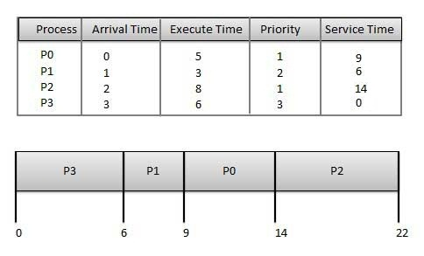
Operating System Presentation
Operating System Scheduling Algorithm:-
Priority Based Scheduling:-

Slide 44
Operating System Presentation
Operating System Scheduling Algorithm:-
Priority Based Scheduling:- Wait time of each process is as follows −
Average Wait Time: (9+5+12+0) / 4 = 6.5
Process | Wait Time : Service Time - Arrival Time
P0 | 9 - 0 = 9
P1 | 6 - 1 = 5
P2 | 14 - 2 = 12
P3 | 0 - 0 = 0

Slide 45
Operating System Presentation
Operating System Scheduling Algorithm:-
Shortest Remaining Time:-
Shortest remaining time (SRT) is the preemptive version of the SJN algorithm.
The processor is allocated to the job closest to completion but it can be preempted by a newer ready job with shorter time to completion.
Impossible to implement in interactive systems where required CPU time is not known.
It is often used in batch environments where short jobs need to give preference.

Slide 46
Operating System Presentation
Operating System Scheduling Algorithm:-
Round Robin Scheduling Algorithm:-
Round Robin is the preemptive process scheduling algorithm.
Each process is provided a fix time to execute, it is called a quantum.
Once a process is executed for a given time period, it is preempted and other process executes for a given time period.
Context switching is used to save states of preempted processes.

Slide 47
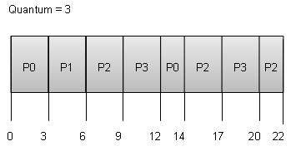
Operating System Presentation
Operating System Scheduling Algorithm:-
Round Robin Scheduling Algorithm:-

Slide 48
Operating System Presentation
Operating System Scheduling Algorithm:-
Round Robin Scheduling Algorithm:- Wait time of each process is as follows −
Average Wait Time: (9+2+12+11) / 4 = 8.5
Process | Wait Time : Service Time - Arrival Time
P0 | (0 - 0) + (12 - 3) = 9
P1 | (3 - 1) = 2
P2 | (6 - 2) + (14 - 9) + (20 - 17) = 12
P3 | (9 - 3) + (17 - 12) = 11

Slide 49
Operating System Presentation
Thread:- A thread is a flow of execution through the process code, with its own program counter that keeps track of which instruction to execute next, system registers which hold its current working variables, and a stack which contains the execution history.
A thread is also called a lightweight process. Threads provide a way to improve application performance through parallelism. Threads represent a software approach to improving performance of operating system by reducing the overhead thread is equivalent to a classical process.

Slide 50
Operating System Presentation
Advantages of Thread:- Threads minimize the context switching time.
Use of threads provides concurrency within a process.
Efficient communication.
It is more economical to create and context switch threads.
Threads allow utilization of multiprocessor architectures to a greater scale and efficiency.

Slide 51
Thank You

